Slide 1




Relationships Between Functionality, Security, and Privacy
For MPC, Hashing, and Encryption
Rio LaVigne
MIT
Notes:
“Expand” MPC in words

Slide 2
Functionality
Security
Privacy
Notes:
Be explicit about the outline of talk is MPC, Hashing, Encryption

Slide 3
Functionality
Multi-Party Computation
Security
Privacy

Slide 4

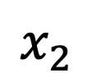
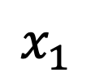
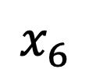
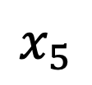
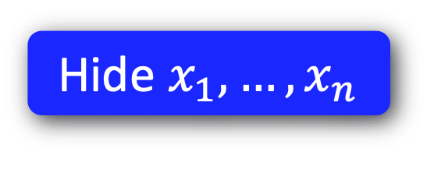
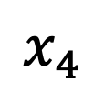
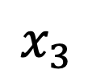
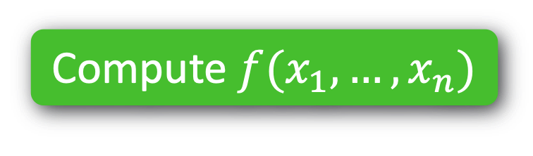
Functionality
Multi-Party Computation
MPC
Security
Compute $f(x_{1},…,x_{n})$
$$x_{2}$$
Passive
$$x_{1}$$
$$x_{3}$$
Active
$$x_{4}$$
$$x_{6}$$
$$x_{5}$$
Hide $x_{1},…,x_{n}$
Privacy
Notes:
All sorts of other things --- polytime vs unbdd

Slide 5
Functionality
Hashing
Security
Privacy

Slide 6
Functionality
Hashing
Security

Slide 7
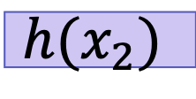

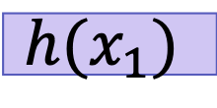

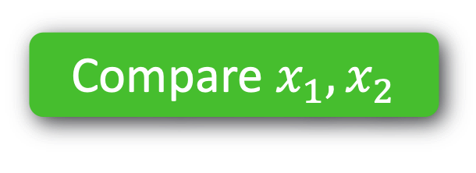

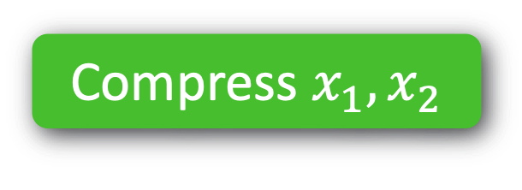


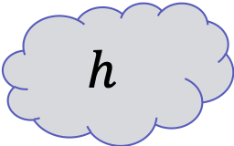
Functionality
Hashing
Security
Compare $x_{1}, x_{2}$
e.g. CRHF
Adaptive
Compress $x_{1}, x_{2}$
$$h$$
$$?$$
$$=$$
$$x_{1}$$
$$x_{2}$$
$$?$$
$$=$$
$$h(x_{1})$$
$$h(x_{2})$$
Notes:
Use technical-sounding terminology

Slide 8
Functionality
Encryption
Security

Slide 9


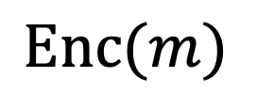
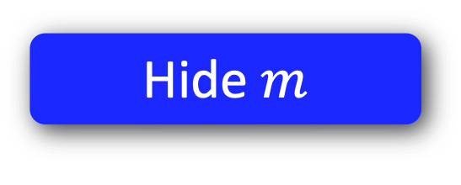

Functionality
Encryption
Security
Send message $m$
Eavesdropper
Poly-time
$$\text{Enc}(m)$$
Hide $m$
Privacy
Notes:
Say: People also look at active MITM

Slide 10
1. MPC with Better Privacy
2. Hashing with Better Functionality
3. Encryption with Better* Security
*subjective & situational
Notes:
SLIDE 10

Slide 11
1. MPC with Better Privacy
2. Hashing with Better Functionality
3. Encryption with Better* Security
*subjective & situational

Slide 12
1. MPC with Better Privacy
1. Topology-Hiding Computation
2. Hashing with Better Functionality
2. Robust Property Preserving Hashing
3. Encryption with Different Security
3. Fine-Grained Cryptography
Notes:
These are the main three directions.. This is what I’m talking

Slide 13
1. Topology-Hiding Computation
2. Robust Property Preserving Hashing
3. Fine-Grained Cryptography

Slide 14

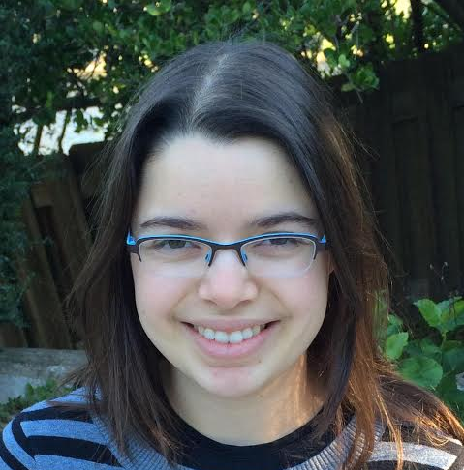


Computes functions on data & graph ☺
Holds personal data & “social graph” ☹
Facebook = “trusted third party”
Notes:
TODO:
Draw myself, Tal, and Adi
Draw FB logo
Draw randos

Slide 15


Slide 16
Goal: Decentralized Social Network
No trusted third party Privacy for data & graph

Slide 17
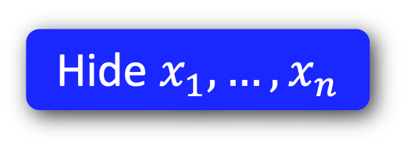
Functionality
MPC
MPC
Security
Passive
Compute $f(x_{1},…,x_{n})$
$$x_{2}$$
Multiparty Computation (MPC) [Yao’86, Goldreich-Micali-Wigderson’87]:
multiple parties can jointly compute a function of their private inputs, while revealing nothing beyond the output
Active
$$x_{1}$$
$$x_{3}$$
Communication topology is public
Complete graph
General public topologies [Dolev-Dwork-Waarts-Yung’93, ..., Halevi-Ishai-Jain-Kushilevitz-Rabin’2016]
$$x_{4}$$
$$x_{6}$$
Hide $x_{1},…,x_{n}$
$$x_{5}$$
Privacy

Slide 18
Functionality
MPC
MPC
Security
Passive
Compute $f(x_{1},…,x_{n})$
$$x_{2}$$
Multiparty Computation (MPC) [Yao’86, Goldreich-Micali-Wigderson’87]:
multiple parties can jointly compute a function of their private inputs, while revealing nothing beyond the output
Active
$$x_{1}$$
$$x_{3}$$
Privacy for your data!
What about metadata?
Communication topology is public
Complete graph
General public topologies [Dolev-Dwork-Waarts-Yung’93, ..., Halevi-Ishai-Jain-Kushilevitz-Rabin’2016]
$$x_{4}$$
$$x_{6}$$
Hide $x_{1},…,x_{n}$
$$x_{5}$$
Privacy

Slide 19
Functionality
Topology-Hiding Computation
MPC
MPC
Security
Passive
Compute $f(x_{1},…,x_{n})$
$$x_{2}$$
Active
$$x_{1}$$
$$x_{3}$$
$$x_{4}$$
$$x_{6}$$
Hide $x_{1},…,x_{n}$
$$x_{5}$$
Hide network
Privacy

Slide 20

Functionality
Topology-Hiding Computation
MPC
MPC
Security
Passive
Compute $f(x_{1},…,x_{n})$
$$x_{2}$$
Active
$$x_{1}$$
$$x_{3}$$
$$x_{4}$$
$$x_{6}$$
Hide $x_{1},…,x_{n}$
$$x_{5}$$
Hide network
Privacy

Slide 21
Topology-Hiding Computation [Moran-Orlav-Richelson’15]
Parties have private inputs
Parties communicate directly only with neighbors.
1
8
2
7
3
4
6
5
The Goal: Given minimal information about the graph
Compute any function of the inputs while revealing nothing beyond function’s output Reveal no more info about the graph
Notes:
In more detail, our setting is that parties all have their own private inputs
parties each know who their neighbors are and can communicate directly only with their neighbors
Our goal is to compute any MPC realizable function on the inputs while revealing nothing about the inputs or the graph
beyond minimal information, like the number of nodes or the diameter
To make our lives easier, we only need to realize topology-hiding broadcast. There are standard methods for compiling broadcast into MPC, and if the broadcast is TH, then the MPC will be as well.

Slide 22

Real
Simulated
Sim
1
b_{out}
1
8
2
$$≈$$
8
2
7
3
4
7
3
4
6
5
5
The Goal: Given minimal information about the graph
Compute any function of the inputs while revealing nothing beyond function’s output Reveal no more info about the graph
Notes:
Do I even need this slide?

Slide 23
1. Topology-Hiding Computation
Standard Model
Adversary | Graph | Hardness Asm. | Reference
Passive | Log diam. | Trapdoor Perm | [Moran-Orlav-Richelson’15]
 | Log diam. | DDH | [Hirt-Maurer-Tschudi-Zikas’16]
 | Cycles, trees… | DDH | [Akavia-Moran’17]
 | Arbitrary | DDH, QR | [Akavia-L-Moran17]
Fail-stop | Arbitrary | DDH, QR, LWE | [L-Liu-Maurer-Moran-Mularczyk-Tschudi’18]
Delaying | Cycles | DDH, QR, LWE | [L-Liu-Maurer-Moran-Mularczyk-Tschudi’18]
Notes:
Semi-honest (first three)
(4th row) Start of my PhD ALM
A little more power FS adversary or Delaying => impossible; NEGATIVE RESULTS
FS can get around by allowing for leakage
Delaying, must take power away from Adversary to get any result
One last line: PKCR is key ingredient & thesis contains a construction of PKCR from LWE

Slide 24
1. Topology-Hiding Computation
Standard Model
Adversary | Graph | Hardness Asm. | Reference
Passive | Log diam. | Trapdoor Perm | [Moran-Orlav-Richelson’15]
 | Log diam. | DDH | [Hirt-Maurer-Tschudi-Zikas’16]
 | Cycles, trees… | DDH | [Akavia-Moran’17]
 | Arbitrary | DDH, QR | [Akavia-L-Moran17]
Notes:
Semi-honest (first three)
(4th row) Start of my PhD ALM
A little more power FS adversary or Delaying => impossible; NEGATIVE RESULTS
FS can get around by allowing for leakage
Delaying, must take power away from Adversary to get any result
One last line: PKCR is key ingredient & thesis contains a construction of PKCR from LWE

Slide 25
1. Topology-Hiding Computation
Standard Model
Adversary | Graph | Hardness Asm. | Reference
Passive | Log diam. | Trapdoor Perm | [Moran-Orlav-Richelson’15]
 | Log diam. | DDH | [Hirt-Maurer-Tschudi-Zikas’16]
 | Cycles, trees… | DDH | [Akavia-Moran’17]
 | Arbitrary | DDH, QR | [Akavia-L-Moran17]
Fail-stop
Impossible [Moran-Orlav-Richelson’15]
Notes:
Semi-honest (first three)
(4th row) Start of my PhD ALM
A little more power FS adversary or Delaying => impossible; NEGATIVE RESULTS
FS can get around by allowing for leakage
Delaying, must take power away from Adversary to get any result
One last line: PKCR is key ingredient & thesis contains a construction of PKCR from LWE

Slide 26
1. Topology-Hiding Computation
Standard Model
Adversary | Graph | Hardness Asm. | Reference
Passive | Log diam. | Trapdoor Perm | [Moran-Orlav-Richelson’15]
 | Log diam. | DDH | [Hirt-Maurer-Tschudi-Zikas’16]
 | Cycles, trees… | DDH | [Akavia-Moran’17]
 | Arbitrary | DDH, QR, LWE | [Akavia-L-Moran17]
Fail-stop | Arbitrary | DDH, QR, LWE | [L-Liu-Maurer-Moran-Mularczyk-Tschudi’18]
Impossible [Moran-Orlav-Richelson’15]
…unless you leak info!
Notes:
Semi-honest (first three)
(4th row) Start of my PhD ALM
A little more power FS adversary or Delaying => impossible; NEGATIVE RESULTS
FS can get around by allowing for leakage
Delaying, must take power away from Adversary to get any result
One last line: PKCR is key ingredient & thesis contains a construction of PKCR from LWE

Slide 27

1. Topology-Hiding Computation
Standard Model
Adversary | Graph | Hardness Asm. | Reference
Passive | Log diam. | Trapdoor Perm | [Moran-Orlav-Richelson’15]
 | Log diam. | DDH | [Hirt-Maurer-Tschudi-Zikas’16]
 | Cycles, trees… | DDH | [Akavia-Moran’17]
 | Arbitrary | DDH, QR, LWE | [Akavia-L-Moran17]
Fail-stop | Arbitrary | DDH, QR, LWE | [L-Liu-Maurer-Moran-Mularczyk-Tschudi’18]
Delaying
Impossible [This Thesis]
SLOW
Notes:
Semi-honest (first three)
(4th row) Start of my PhD ALM
A little more power FS adversary or Delaying => impossible; NEGATIVE RESULTS
FS can get around by allowing for leakage
Delaying, must take power away from Adversary to get any result
One last line: PKCR is key ingredient & thesis contains a construction of PKCR from LWE

Slide 28
Delaying Adversary Model
b_{out}
Broadcast
Delaying
Polynomially unbounded delay
Change message orders, etc…
SLOW
Notes:
TODO
Reference distributed algorithms of FLB: Byzantine agreements/Broadcast 1982 or 1983
IN THESIS
Mention it here ☺
https://groups.csail.mit.edu/tds/papers/Lynch/FischerLynchMerritt-dc.pdf

Slide 29

Impossibility of THC with Adversarial Delays
1
2
3
4
5
6
7
S
9
10
11
vs.
11
10
9
4
5
6
7
S
3
2
1
Is $2$ close to the source?
Notes:
TODO: renumber

Slide 30

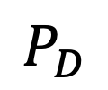

Impossibility of THC with Adversarial Delays
1
2
3
4
5
6
7
S
9
10
11
$$P_{D}$$
vs.
11
10
9
4
5
6
7
S
3
2
1
Is $P_{D}$ close to the source?

Slide 31
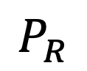
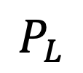
Impossibility of THC with Adversarial Delays
1
2
3
4
5
6
7
S
9
10
11
SLOW
SLOW
$$P_{D}$$
$$P_{L}$$
$$P_{R}$$
vs.
11
10
9
4
7
6
9
S
3
2
1
SLOW
SLOW
Is $P_{D}$ close to the source?

Slide 32
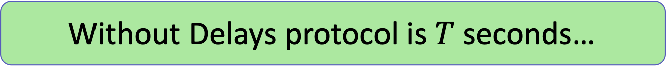

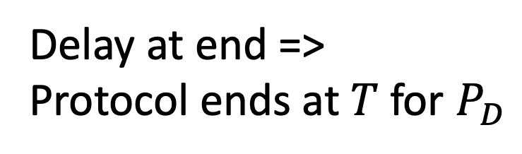
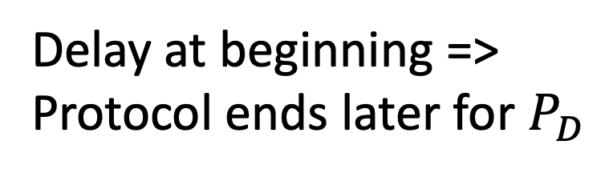
Impossibility of THC with Adversarial Delays
Consider any protocol…
1
2
3
4
5
6
7
S
9
10
11
SLOW
SLOW
$$P_{D}$$
$$P_{L}$$
$$P_{R}$$
Without Delays protocol is $T$ seconds…
Delay $T$ seconds?
11
10
9
4
7
6
9
S
3
2
1
SLOW
SLOW
Delay at beginning =>
Protocol ends later for $P_{D}$
Delay at end =>
Protocol ends at $T$ for $P_{D}$

Slide 33
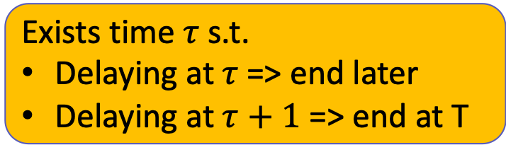
Impossibility of THC with Adversarial Delays
1
2
3
4
5
6
7
S
9
10
SLOW
SLOW
$$P_{D}$$
$$P_{L}$$
$$P_{R}$$
Exists time $τ$ s.t.
Delaying at $τ$=> end later
Delaying at $τ+1$ => end at T
10
9
4
7
6
9
S
3
2
1
SLOW
SLOW
Delay at beginning =>
Protocol ends later for $P_{D}$
Delay at end =>
Protocol ends at $T$ for $P_{D}$

Slide 34
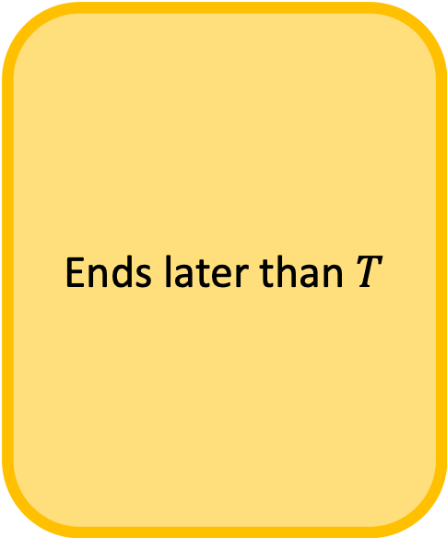
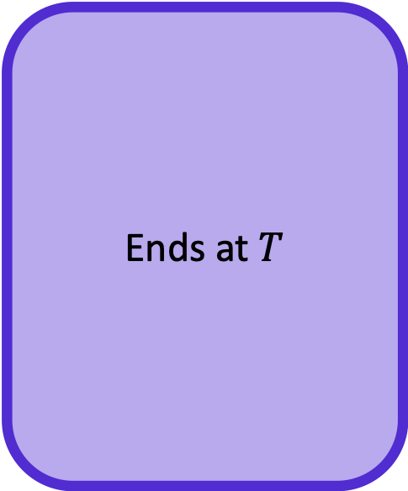
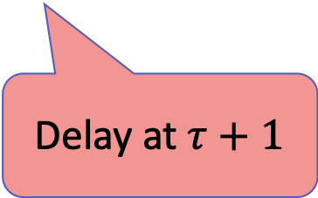
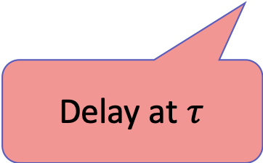
Impossibility of THC with Adversarial Delays
Ends later than $T$
Ends at $T$
1
2
3
4
5
6
7
S
9
10
SLOW
SLOW
$$P_{D}$$
$$P_{L}$$
$$P_{R}$$
Exists time $τ$ s.t.
Delaying at $τ$=> end later
Delaying at $τ+1$ => end at T
10
9
4
7
6
9
S
3
2
1
SLOW
SLOW
Delay at $τ$
Delay at $τ+1$

Slide 35
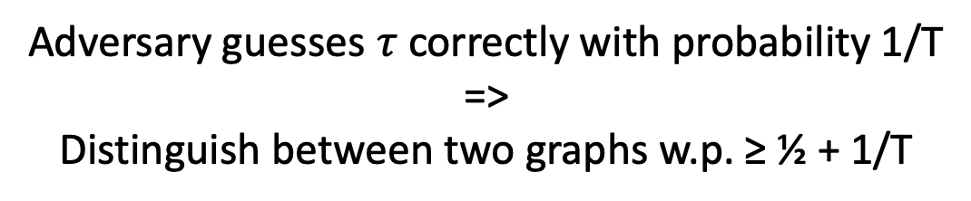
Impossibility of THC with Adversarial Delays
1
2
3
4
5
6
7
S
9
10
11
SLOW
SLOW
$$P_{D}$$
$$P_{L}$$
$$P_{R}$$
Exists time $τ$ s.t.
Delaying at $τ$=> end later
Delaying at $τ+1$ => end at T
Adversary guesses $τ$ correctly with probability 1/T
=>
Distinguish between two graphs w.p. ≥ ½ + 1/T

Slide 36
1. Topology-Hiding Computation
Standard Model
Adversary | Graph | Hardness Asm. | Reference
Semi-Honest | Log diam. | Trapdoor Perm | [Moran-Orlav-Richelson’15]
 | Log diam. | DDH | [Hirt-Maurer-Tschudi-Zikas’16]
 | Cycles, trees… | DDH | [Akavia-Moran’17]
 | Arbitrary | DDH, QR, LWE | [Akavia-L-Moran17]
Fail-stop | Arbitrary | DDH, QR, LWE | [L-Liu-Maurer-Moran-Mularczyk-Tschudi’18]
Delaying
Impossible [This Thesis]
Delays must be a property of network,
not adversarial…
SLOW
Notes:
Semi-honest (first three)
(4th row) Start of my PhD ALM
A little more power FS adversary or Delaying => impossible; NEGATIVE RESULTS
FS can get around by allowing for leakage
Delaying, must take power away from Adversary to get any result
One last line: PKCR is key ingredient & thesis contains a construction of PKCR from LWE

Slide 37
1. Topology-Hiding Computation
Standard Model
Adversary | Graph | Hardness Asm. | Reference
Semi-Honest | Log diam. | Trapdoor Perm | [Moran-Orlav-Richelson’15]
 | Log diam. | DDH | [Hirt-Maurer-Tschudi-Zikas’16]
 | Cycles, trees… | DDH | [Akavia-Moran’17]
 | Arbitrary | DDH, QR, LWE | [Akavia-L-Moran17]
Fail-stop | Arbitrary | DDH, QR, LWE | [L-Liu-Maurer-Moran-Mularczyk-Tschudi’18]
Delaying | Cycles | DDH, QR, LWE | [L-Liu-Maurer-Moran-Mularczyk-Tschudi’20]
Notes:
Semi-honest (first three)
(4th row) Start of my PhD ALM
A little more power FS adversary or Delaying => impossible; NEGATIVE RESULTS
FS can get around by allowing for leakage
Delaying, must take power away from Adversary to get any result
One last line: PKCR is key ingredient & thesis contains a construction of PKCR from LWE

Slide 38
Summary of THC results
LWE implies THC (Quantum secure)
Adversaries that can delay messages can learn topology
Any THC result dealing with real-world networks must not allow adversarial control over message timings OR must leak information
Positive result in the Probabilistic Unknown Delay Model [L-Liu-Maurer-Moran-Mularczyk-Tschudi’20]
SLOW

Slide 39
1. Topology-Hiding Computation
2. Robust Property Preserving Hashing
3. Fine-Grained Cryptography

Slide 40
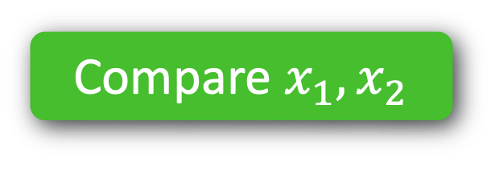

2. Robust Property Preserving Hashing
Functionality
Security
Compare $x_{1}, x_{2}$
Adaptive
Compress $x_{1}, x_{2}$
$$h$$
$$?$$
$$=$$
$$x_{1}$$
$$x_{2}$$
$$?$$
$$=$$
$$h(x_{1})$$
$$h(x_{2})$$
Notes:
Use technical-sounding terminology

Slide 41


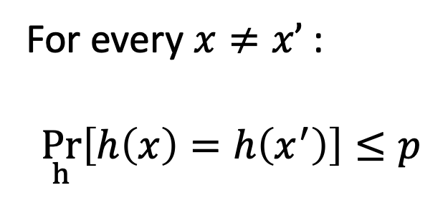
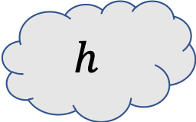
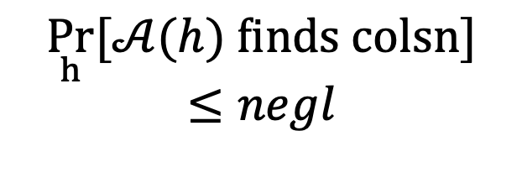
Universal Hash
Collision-Resistant
Hash
For every $x≠x’$:
$$\underset{h}{Pr}\left[h\left(x\right)=h\left(x^{′}\right)\right]≤p$$
$$\underset{h}{Pr}[𝒜(h) \text{finds} \text{colsn}]≤negl$$
$$h$$
Robust
Locality-Sensitive
Hash [This Thesis]
Locality-Sensitive
Hash [Indyk-Motwani‘98]

Slide 42
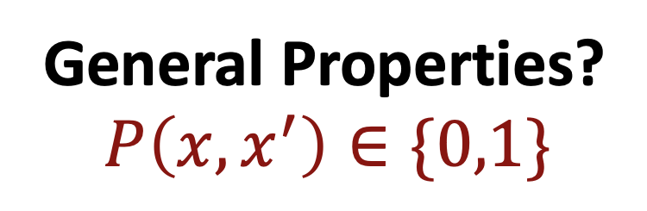
Universal Hash
Collision-Resistant
Hash
For every $x≠x’$:
$$\underset{h}{Pr}\left[h\left(x\right)=h\left(x^{′}\right)\right]≤p$$
$$\underset{h}{Pr}[𝒜(h) \text{finds} \text{colsn}]≤negl$$
$$h$$
General Properties?
$$P\left(x,x^{′}\right)∈\{0,1\}$$

Slide 43
Universal Hash
Collision-Resistant
Hash
For every $x≠x’$:
$$\underset{h}{Pr}\left[h\left(x\right)=h\left(x^{′}\right)\right]≤p$$
$$\underset{h}{Pr}[𝒜(h) \text{finds} \text{colsn}]≤negl$$
$$h$$
Robust
Property-Preserving
Hash [This Thesis]
Property-Preserving
Hash

Slide 44
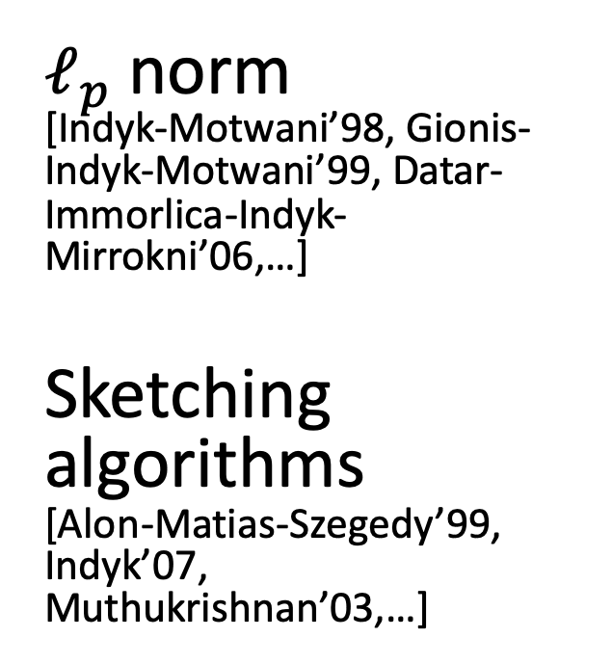
Property-Preserving
Hash
Robust
Property-Preserving
Hash [This Thesis]
$ℓ_{p}$ norm [Indyk-Motwani’98, Gionis-Indyk-Motwani’99, Datar-Immorlica-Indyk-Mirrokni’06,…]
Sketching algorithms [Alon-Matias-Szegedy’99, Indyk’07, Muthukrishnan’03,…]
$$h$$
Notes:
Sketching algorithms for graphs etc

Slide 45
Property-Preserving
Hash
Robust
Property-Preserving
Hash [This Thesis]
$ℓ_{p}$ norm [Indyk-Motwani’98, Gionis-Indyk-Motwani’99, Datar-Immorlica-Indyk-Mirrokni’06,…]
Sketching algorithms [Alon-Matias-Szegedy’99, Indyk’07, Muthukrishnan’03,…]
[Hardt-Woodruff’13]
$$h$$
Impossible from Strengthened Communication-Complexity Lower bounds
[This Thesis]
Gap-Hamming Constructions [This Thesis]

Slide 46
Property-Preserving
Hash
Robust
Property-Preserving
Hash [This Thesis]
$ℓ_{p}$ norm [Indyk-Motwani’98, Gionis-Indyk-Motwani’99, Datar-Immorlica-Indyk-Mirrokni’06,…]
Sketching algorithms [Alon-Matias-Szegedy’99, Indyk’07, Muthukrishnan’03,…]
[Hardt-Woodruff’13]
$$h$$
Impossible from Strengthened Communication-Complexity Lower bounds
[This Thesis]
Gap-Hamming Constructions [This Thesis]

Slide 47

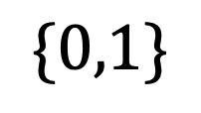
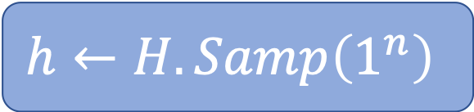
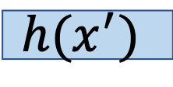

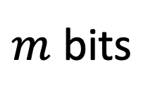

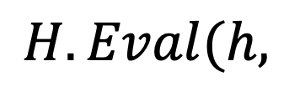

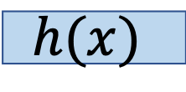

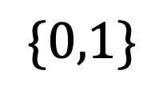
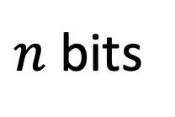
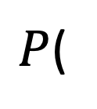
Definitions
Robust PPH family $H$ for two-input predicate $P$
$$h←H.Samp\left(1^{n}\right)$$
$n$ bits
$P$(
$$x$$
$$,$$
$$x′$$
$$)$$
$$\{0,1\}$$
$$H.Eval(h,$$
$$h(x)$$
$$,$$
$$h(x^{′})$$
$$)$$
$$\{0,1\}$$
$m$ bits
and robust

Slide 48

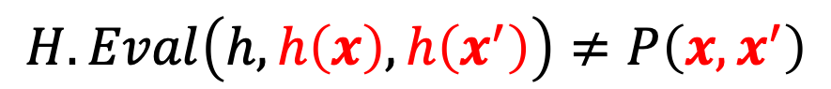
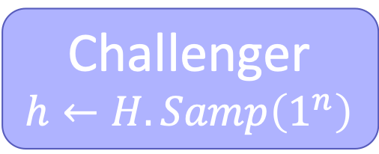
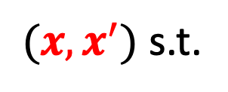
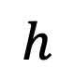
Primary Notion of Robustness
Challenger
$$h←H.Samp\left(1^{n}\right)$$
$$h$$
$(x,x^{′})$ s.t.
$$H.Eval\left(h,h\left(x\right),h\left(x^{′}\right)\right)≠P\left(x,x^{′}\right)$$
Notes:
Non-robust (no h)
-> Gap-Hamming predicate and then construction

Slide 49

Gap-Hamming Preserving Hash
CLOSE vs FAR Hamming Distance
Adaptive
Compress $x_{1}, x_{2}$
$$h$$

Slide 50
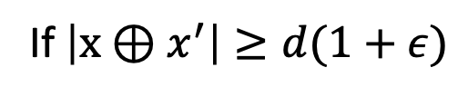

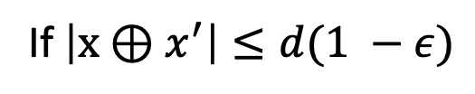



Gap-Hamming Predicate
Let $P(x,x’)$ be the $(n,d,ε)$ Gap-Hamming Predicate
$$0$$
If $\left|x⊕x^{′}\right|≤d(1 −ε)$
“CLOSE”
$$P(x,x′)=$$
$$1$$
If $\left|x⊕x^{′}\right|≥d(1+ε)$
“FAR”
$$⋆$$
Otherwise
Notes:
So, we focus on the gap-hamming predicate, which instead of just giving equal-or-not, can describe whether two inputs are close or far.
Ideally you want constant fraction for d…

Slide 51
PPH Constructions for Gap-Hamming Distance
Both use same concept
Collision-Resistant Hash functions
Common, weak assumption
New coding-theoretic assumption
Different parameters
Related to hardness of syndrome decoding
Expand
Compress

Slide 52


CRHF Construction
0
0
1
1
0
0
$(n,d,ε)$ Gap-Hamming
Bipartite
Expander
Bipartite Expander
$d=O\left(n^{1−δ}\right)$
$ε=Ω(1)$
Any constant compression!
0
0
0
1
0
1
0
0
CRHF
0
1
1
0
Notes:
Get a larger center d if we assume exponentially secure CRHFs
(idea: subsets in the middle can be smaller)

Slide 53






Landscape of PPH’s
No compression
Lots of Compression
$≥n$ bits
$O(n)$ bits
$ω(log\left(n\right))$ bits
$0$ bits
Constant Gap-Hamming
CRHF Construction
Coding Construction
$$\text{Equality}\text{ (}\text{CRHFs}\text{)}$$
$1/\sqrt{n}$ Gap-Hamming, Index, Greater-than,…
One-Way Communication
[This Thesis]
Notes:
“In the second construction, we can handle d = n/log n.”

Slide 54
1. Topology-Hiding Computation
2. Robust Property Preserving Hashing
3. Fine-Grained Cryptography
Notes:
SLIDE 64

Slide 55

3. Fine-Grained Cryptography
Send message $m$
Eavesdropper
Hide $m$

Slide 56


3. Fine-Grained Cryptography
Send message $m$
Send message $m$ in time $O(n^{a})$
Eavesdropper
Eavesdropper running in time $O(n^{a+c})$
But why?
Hide $m$

Slide 57
BPP ≠ NP
(=> P ≠ NP)
Average Case Hard problems
Efficiently generate hard distribution + know solutions
One-Way Function
Efficiently generate hard distribution + trapdoor
Public key crypto
Notes:
TODO: this slide should introduce the core issues of a world without OWFs, why we rely on P ≠ NP for crypto

Slide 58
Rely on increasingly strong assumptions about P & BPP
BPP ≠ NP
(=> P ≠ NP)
Average Case Hard problems
Efficiently generate hard distribution + know solutions
One-Way Function
Efficiently generate hard distribution + trapdoor
Public key crypto
Notes:
TODO: this slide should introduce the core issues of a world without OWFs, why we rely on P ≠ NP for crypto

Slide 59
Can we have a meaningful notion of cryptography even if P=NP?
Notes:
TODO: put this in bold in the middle

Slide 60
Can we have a meaningful notion of cryptography even if P=NP?
YES!
Notes:
TODO: put this in bold in the middle

Slide 61

Related works: Fine Grained Public Key Crypto
Paper | Assumptions | Crypto | Complexity | Adversary Time
[Merkle78] [Biham-Goren-Ishai’08] | $2^{n}$-Strong OWFs | Key Exchange | $$O(N)$$ | $$Ω(N^{2})$$
Notes:
To start off this discussion, let’s mention Merkle Puzzles, the original fine-grained key exchange. Based on either Random Oracles, or very very strong OWFs, we can get a key exchange with an N^2 “gap” between runtime and the time it takes an adversary to break.
But wait, we said we were in a world without OWFs…
Merkle 78
E. Biham, Y. J. Goren, and Y. Ishai. 08,
M. Ball, A. Rosen, M. Sabin, and P. N. Vasudevan 18
A. Degwekar, V. Vaikuntanathan, and P. N. Vasudevan 16

Slide 62

Related works: Fine Grained Public Key Crypto
Paper | Assumptions | Crypto | Complexity | Adversary Time
[Merkle78] [Biham-Goren-Ishai’08] | $2^{n}$-Strong OWFs | Key Exchange | $$O(N)$$ | $$Ω(N^{2})$$
[This Thesis] | Average-Case Zero k-Clique | OWF PKE PKE | $O(N)$ $$O(N)$$ $$O(N)$$ | $$Ω(N^{k/2 })$$ $$Ω\left(N^{1.5−δ}\right)$$ $$Ω(N^{2−δ})$$
Generic properties
Specific properties of Zero-k-Clique
Notes:
Other resources: space (bdd storage Ueli Mauer etc), parallel time (DVV)
n time, n^2 invert
Merkle 78
E. Biham, Y. J. Goren, and Y. Ishai. 08,
M. Ball, A. Rosen, M. Sabin, and P. N. Vasudevan 18
Degwekar, V. Vaikuntanathan, and P. N. Vasudevan 1

Slide 63

Related works: Fine Grained Public Key Crypto
Paper | Assumptions | Crypto | Honest Complexity | Adversary Time
[M78] [BGI08] | $2^{n}$-Strong OWFs | Key Exchange | $$O(N)$$ | $$Ω(N^{2})$$
[Degwekar-Vaikuntanathan-Vasudevan’16] | NC1≠⊕L/poly | OWF + PKE | NC1 | >NC1
[This Thesis] | Average-Case Zero k-Clique | OWF PKE PKE | $O(N)$ $$O(N)$$ $$O(N)$$ | $$Ω(N^{k/2 })$$ $$Ω\left(N^{1.5−δ}\right)$$ $$Ω(N^{2−δ})$$
Generic properties
Specific properties of Zero-k-Clique
Notes:
Other resources: space (bdd storage Ueli Mauer etc), parallel time (DVV)
n time, n^2 invert
Merkle 78
E. Biham, Y. J. Goren, and Y. Ishai. 08,
M. Ball, A. Rosen, M. Sabin, and P. N. Vasudevan 18
Degwekar, V. Vaikuntanathan, and P. N. Vasudevan 1

Slide 64










Fine-Grained Assumption Zero k-Clique
Distribution
Complete k-partite graph
$w_{i,j}\sim ℤ_{R}$
$a,b,c\sim [n]$
$w_{a,b}=−(w_{a,c}+w_{b,c})$
$$w_{i,j}$$
$$n$$
$$a$$
$$b$$
Average-Case Assumption
Finding $a,b,c$ takes
$$c$$
$$={Ω(n}^{k})$$
$3$-partite

Slide 65











Fine-Grained Key Exchange Merkle Puzzles?
9
8
7
Input Universe ${\left\{0,1\right\}}^{n}$
6
5
4
1
publish $2^{n/2}$evaluations
2
3
4
4
$$f( )$$
2
$$f( )$$
7
1
2
1
9
$$f( )$$
$$f( )$$
4
4
Key $=$
$$f( )$$
Key $=$
4
4
$$f( )$$
9
7
$$=O({2^{n/2}n}^{2})$$
$$=O({2^{n/2}n}^{2})$$
$$=Ω(n^{k})$$
Notes:
Where does Merkle fail?

Slide 66


Fine-Grained Key Exchange Merkle Puzzles, but different
Generate $ℓ$ ZkC Instances
Plant $\sqrt{ℓ}$solutions
Check Alice’s list for solution
Notes:
Rio

Slide 67




Fine-Grained Key Exchange Merkle Puzzles, but different
Generate $ℓ$ ZkC Instances
Plant $\sqrt{ℓ}$solutions
Check Alice’s list for solution
5. $b=\left\langle i,v\right\rangle$
$$\text{index} i$$
4. Publish $v\sim U_{\log{(ℓ)}}$
$$v$$
Notes:
Rio

Slide 68




Fine-Grained Key Exchange Merkle Puzzles, but different
Time Alice & Bob:
$O(ℓn^{2})$
$O(\sqrt{ℓ})$
$O(\sqrt{ℓ}⋅n^{k})$
Generate $ℓ$ ZkC Instances
Plant $\sqrt{ℓ}$solutions
Check Alice’s list for solution
5. $b=\left\langle i,v\right\rangle$
$$n^{2k−4}$$
$${O(n}^{2k−2 })$$
Notes:
Rio
After minimizing wrt ell and n, we get that A & B only need n^{2k – 2} time to run this protocol.
ell = n^{2k – 4}
… Hope that Eve

Slide 69



Fine-Grained Key Exchange Merkle Puzzles, but different
$$n^{2k−4}$$
$${O(n}^{2k−2 })$$
$${O(n}^{2k−2 })$$
Need a proof!
$$=Ω(n^{3k −4})$$
Notes:
Rio

Slide 70
Fine-Grained Key Exchange Security reduction
LOCATION
of the ZKC
Index of the
ZKC pair
Reduces
i
Notes:
SLIDE 85
Maybe don’t go through the reduction...

Slide 71



Fine-Grained Key Exchange Security reduction
01011101
i
i
i
List-Hard
Splittable
Plantable
Notes:
Andrea
There is a significant amount of error and correlation to deal with here.

Slide 72



Fine-Grained Crypto Summary of Results
Definitions
FG-OWFs and FG-HC bits
FG-KeyXC
FG-PKE
Assumptions
3-Sum and k-Sum
Zero-k-Clique
Constructions
FG-OWF and HC Bits
FG-KeyXC and PKE
$$={O(n}^{2k−2 })$$
$$={Ω(n}^{3k−4 })$$
“Better KeyXC” with gap ${O(n}^{k+2 })$ vs ${Ω(n}^{2k })$

Slide 73
Summary
1. Topology-Hiding Computation
2. Robust Property Preserving Hashing
3. Fine-Grained Cryptography

Slide 74


THANK YOU!

Slide 75



Slide 76


Slide 77









Slide 78


Slide 79







Slide 80
1. Topology-Hiding Computation
2. Robust Property Preserving Hashing
THANK YOU!
3. Fine-Grained Cryptography

Slide 82
PKCR

Slide 83
1. Topology-Hiding Computation
Standard Model
Adversary | Graph | Hardness Asm. | Reference
Semi-Honest | Log diam. | Trapdoor Perm | [MOR15]
 | Log diam. | DDH | [HMTZ16]
 | Cycles, trees… | DDH | [AM17]
 | Arbitrary | DDH, QR | [ALM17]
Fail-stop | Arbitrary | DDH, QR, LWE | [LLMMMT18]
Delaying | Cycles | DDH, QR, LWE | [LLMMMT20]
Notes:
TODO: write out citations

Slide 84
1. Topology-Hiding Computation
Standard Model
Adversary | Graph | Hardness Asm. | Reference
Semi-Honest | Log diam. | Trapdoor Perm | [MOR15]
 | Log diam. | DDH | [HMTZ16]
 | Cycles, trees… | DDH | [AM17]
 | Arbitrary | DDH, QR | [ALM17]
Fail-stop | Arbitrary | DDH, QR, LWE | [LLMMMT18]
Delaying | Cycles | DDH, QR, LWE | [LLMMMT20]
PKCR
Encryption

Slide 85
PKCR Encryption
(Privately Key-Commutative Randomizable)
Add Layer
[m]
sk₂
[m]
,
*
pk₁
pk₂
Delete Layer
sk₂
[m]
[m]
,
*
pk₁
pk₁
pk₂
Notes:
TODO: remove the green
Discuss that we’re not explicitely “adding a layer”, but rather changing the pks.
CT looks the same after this op: same as encrypting under fresh pk.

Slide 86
1. Topology-Hiding Computation
Quantum-Secure
DDH
or
PKCR
QR
or
LWE

Slide 87

























Regev’s PKE Scheme [Regev’05]
$$e$$
$$A$$
$$b$$
$$s$$
Keygen:
$$← ℤ_{q}^{n}$$
$←$ error
$$←N_{q}{\left(0,σ\right)}^{m×n}$$
$$←As+e$$
$$sk$$
Master PK
$$pk$$
$$←x^{T}A$$
$$←x^{T}b+μ⋅\left\lfloor \left.\frac{q}{2}\right\rceil \right.$$
$$x$$
$$c_{1}$$
$$c_{2}$$
Encryption($μ,A,b$):
$$←{\left\{0,1\right\}}^{m}$$
$$ct$$
$$μ← \left(\frac{q}{4},\frac{3q}{4}\right)∋\left[ − − \right]$$
$$s$$
Decryption($(c_{1},c_{2}),s$):
$$c_{2}$$
$$c_{1}$$
$$μ⋅\left\lfloor \left.\frac{q}{2}\right\rceil \right.+ x^{T}(b −As)$$
$$e$$
Notes:
TODO: flesh this out

Slide 88


























Regev’s PKE is PKCR [LLMMMT’18]
Add Layer
[m]
*
[m]
pk₁
sk₂
pk₁
pk₂
,
,
,
$${ b}_{1}$$
$${ b}_{1}$$
$${ b}_{2}$$
$$($$
$$c_{1}$$
$$,$$
$$c_{2}$$
$$)$$
,
,
$${ s}_{2}$$
$$+$$
,
$$($$
$$c_{1}$$
$$,$$
$$c_{2}$$
$$+$$
$$c_{1}$$
$${ s}_{2}$$
$$)$$
$$($$
$$x^{T}A$$
$$)$$
$$μ⋅\left\lfloor \left.\frac{q}{2}\right\rceil \right.+x^{T}b_{1}+x^{T}A⋅s_{2}$$
$$,$$
Need to randomize $x^{T}$
Randomization adds error to CT
Remove Layer just Decryption
$$\left(A⋅{(s}_{1}+s_{2})+e\right)$$
$$x^{T} \left(A⋅s_{1}+A⋅s_{2}+e\right)$$
$${ b}^{∗}$$
= pk*
Notes:
TODO: flesh this out

Slide 89
Equality PPH

Slide 90





Warmup: Equality-Preserving Hash
(Collision-Resistance Hash Families)
Given $h$ sampled from $H$, hard to find a collision
Challenger
$$h←H.Samp\left(1^{n}\right)$$
$$h$$
$(x,x^{′})$ s.t.
$h\left(x\right)=h(x^{′})$ and $x≠x′$
One of $H.Eval$must be incorrect:
$$H.Eval\left(h,h\left(x\right),h\left(x^{′}\right)\right)=H.Eval\left(h,h\left(x\right),h\left(x\right)\right)$$

Slide 91



Warmup: Equality-Preserving Hash
(Collision-Resistance Hash Families)
In other words…
$H$ is CRHF
$$⇔$$
$H$is Equality PPH
Same security guarantees!
Notes:
“We would like to get PPH for properties other than equality, so…”

Slide 92
OWC Model

Slide 93








One-Way Communication Model
Evaluate function $P$ on $x, x’$
Public randomness $r$
$$g_{a}\left(x,r\right)$$
$$P(x,x^{′})$$
$$x$$
$$x′$$
$$r$$
$$r$$
w.p. $≥p$
Goal: minimize ${|g}_{a}\left(x,r\right)|$
Notes:
Any LB in OWCC => LB for hash functions, BUT we need exact LBs
We show impossibility for a gap-hamming predicate with a relatively small gap – note that our constructions have a relatively large gap, and so gets around this LB.
…
Emphasize what we do
2 mins

Slide 94







PPH implies OWC Protocol
Evaluate predicate $P$ on $x, x’$
Publicly sampled $h$
$$h(x)$$
$$H.Eval$$
$$P(x,x^{′})$$
$$x$$
$$x′$$
$$h$$
$$h$$
w.p. $≥1 −negl(n)$

Slide 95


















PPH implies OWC Protocol
OWC Protocol
$$⟸$$
Robust PPH
$P$(
$$x$$
$$,$$
$$x′$$
$$)$$
$$g_{a}\left(x,r\right)$$
$$P(x,x^{′})$$
$$x$$
$$x′$$
w.p. $≥1−negl$
$$H.Eval(h,$$
$$h(x)$$
$$,$$
$$h(x^{′})$$
$$)$$
$$r$$
$$r$$
Lower bound $\left|g_{a}\left(x,r\right)\right| ⟹$ Lower bound on $|h\left(x\right)|$
Existing OWC lower bounds of form $Ω(n)$… but we need to be exact!

Slide 96





Existing Lower Bounds from OWC
$$h(x)$$
$$H.Eval$$
$$P(x,x^{′})$$
$$x$$
$$x′$$
$\left(n,\frac{n}{2},\frac{c}{\sqrt{n}}\right)$-Gap-Hamming requires $Ω(n)$ bits of OWC [﻿Jayram-﻿Kumar-﻿Sivakumar’08]
$\left(n,\frac{n}{2},\frac{1}{\sqrt{n}}\right)$-Gap-Hamming requires $n$ bits of OWC [This Work]
Greater-Than requires $Ω(n)$ bits of OWC [﻿Ramamoorthy-Sinha’15]
Greater-Than requires $n$ bits of OWC [This Work]

Slide 97
Existing Lower Bounds from OWC
$$h(x)$$
$$H.Eval$$
$$P(x,x^{′})$$
$$x$$
$$x′$$
$\left(n,\frac{n}{2},\frac{c}{\sqrt{n}}\right)$-Gap-Hamming requires $Ω(n)$ bits of OWC [﻿Jayram-﻿Kumar-﻿Sivakumar’08]
$\left(n,\frac{n}{2},\frac{1}{\sqrt{n}}\right)$-Gap-Hamming requires $n$ bits of OWC [This Work]
Refinement of analysis…
Greater-Than requires $Ω(n)$ bits of OWC [﻿Ramamoorthy-Sinha’15]
Greater-Than requires $n$ bits of OWC [This Work]
Greater-Than is a Reconstructing Predicate

Slide 98






Reconstructing Predicate $P$
Learner
Query $x_{i}$
$$P , x$$
$$P({x,x}_{i})$$
E.g: Index, Greater-Than, Exact-Hamming,…
$$x′$$
$x^{′}=x$ with 1 – negl(n) probability

Slide 99


Reconstructing Predicate Lower Bounds
$$P , x$$
$$x′$$
If $P$ is reconstructing, then a (nontrivial) PPH does not exist for $P$.
Intuition: $P$ can describe all $n$ bits of $x$, so cannot compress…

Slide 100











Example: Greater Than
$$>,x$$
$$h\left(x\right)$$
$$P\left(x,x^{∗}\right)$$
or
$P\left(x^{′},x^{∗}\right)$?
$$x$$
$$x^{∗}$$
Binary search
$$∃x^{′}≠x$$
$$h(x)=h(x’)$$
w.p. at least 1/2
$$x^{∗}$$
$$x$$
0
$$2^{n}−1$$
$$x′$$
$$P\left(x,x^{∗}\right)≠P\left(x^{′},x^{∗}\right)$$

Slide 101


Example: Greater Than
$$>,x$$
$$h\left(x\right)$$
$$P\left(x,x^{∗}\right)$$
or
$P\left(x^{′},x^{∗}\right)$?
$$x$$
$$x^{∗}$$
Binary search
Third Query!
$$x$$
0
$$2^{n}−1$$
Need to guess which query (with prob 1/n)
$$x′$$
Query 1
Query 2
Notes:
Notice that later queries do NOT distinguish x and x’.. Just the one

Slide 102
Coding PPH Construction

Slide 103






Coding-Theoretic PPH Construction
Nearest-Neighbor Construction [Kushilevitz-Ostrovsky-Rabani’98]
Way too good…
n
For any:
$d∈\left[n\right]$
$ε=Ω\left(1\right)$
$m=Ω(n)$
$$A$$
$$x$$
m
$$y$$
=
m
Ber$(1/d)$ entries
Not robust!!!
For threshold $τ=τ(n,d,ε)$, for any $x∈{\left\{0,1\right\}}^{n}$
$\left|x\right|≤ d(1−ε),$then $\underset{A}{Pr}\left[\left|Ax\right|>τ\right]=negl\left(n\right)$
$\left|x\right|≥ d(1+ε),$then $\underset{A}{Pr}\left[\left|Ax\right|<τ\right]=negl\left(n\right)$
Notes:
Note that here x is the difference between two inputs. Because everything is linear, we just care about preserving the hamming weight of the difference.
Also note that this is a NON ROBUST construction, which is why we can get a d like that…
Computing tau:
Mu_1 = m/2 (1 – e^{-2(1 – eps)} )
Mu_2 = m/2 (1 – e^{-2(1 + \eps)} )
Go through the probability that any row in A dotted with x is 1 conditioned on the weight of x and then you can get these bounds.
Tau = ½ (mu1 + mu2)

Slide 104

Coding-Theoretic PPH Construction
Getting robustness…
n
For any:
$d=n/\log{n}$
$ε=Ω\left(1\right)$
$m=Ω(n)$
$$A$$
$$x$$
m
$$y$$
=
m
Ber$(1/d)$ entries
If $d$ small enough, then $\underset{A}{Pr}\left[∃\left|x\right|≤d\left(1−ε\right) s.t. \left|Ax\right|>τ\right]=negl\left(n\right)$
Large vectors and Gaussian Elimination?
What if our domain is SPARSE?
Notes:
Small enough d = n/log n
Computing tau:
Mu_1 = m/2 (1 – e^{-2(1 – eps)} )
Mu_2 = m/2 (1 – e^{-2(1 + \eps)} )
Go through the probability that any row in A dotted with x is 1 conditioned on the weight of x and then you can get these bounds.
Tau = ½ (mu1 + mu2)

Slide 105







Coding-Theoretic Assumption
Let $x∈{\left\{0,1\right\}}^{n}$ be $β$-sparse.
$\left|x\right|≤d(1 −ε)$ is “small” and $d\left(1+ε\right)≤\left|x\right|≤βn$ is “medium”
n
$$A$$
$$A$$
$$x$$
m
$$y$$
=
m
$x$ s.t.
$|x|$ and $|y|$…
Know:
$|x|$ small or medium
$|y| = 0$ is hard (Syndrome Decoding)
[Applebaum-Haramaty-Ishai-Kushilevitz-Vaikuntanathan’17]
Assumption:
$|x|$ medium
$|y|$ small (less than $τ$) is hard
Notes:
Computing tau:
Mu_1 = m/2 (1 – e^{-2(1 – eps)} )
Mu_2 = m/2 (1 – e^{-2(1 + \eps)} )
Go through the probability that any row in A dotted with x is 1 conditioned on the weight of x and then you can get these bounds.
Tau = ½ (mu1 + mu2)

Slide 106








Coding-Theoretic Construction
$$x′$$
$(n,d,ε)$ Gap-Hamming
$$x$$
Sparsify:
Non-linear
Deterministic
Approx. preserves Hamming dist.
For any:
Constant compression*
$ε=O\left(1\right)$
$d≤\frac{n}{2\log{n}}(\left(1 −ε\right)+\left(1+ε\right))$
$$Ax′$$
$$y$$
Ber$(1/d)$
Recall CRHF construction:
$$d=O\left(n^{1−δ}\right)$$
$β$-sparse
* Depending on the assumption you’re willing to make…

Slide 107
FG Key Exchange Reduction

Slide 108
3. Fine-Grained Key Exchange ZkC Properties
Three Properties
List Hard
Splittable
Plantable
01011101
Notes:
ANY PROBLEM WITH THESE PROPERTIES
We can do this with three properties. It is both the case that ZKC has these properties and that any problem with these properties will create a PKE.
Listhard, which lets us say that finding the index of a solution in a list requires that every problem in that list be solved in n^k time. This is an efficient self reduction.
Splittable splits the high order bits and low order bits of the weights on the edges, so you’ll start with one problem that has weights mod R and end up with two problems over mod sqrt(R).
Finally, plantable. We need to be able to plant cliques into instances with out any.

Slide 109





3. Fine-Grained Key Exchange Security reduction
01011101
$$ℓ$$
$$n^{k}$$
i
i
i
$${ℓn}^{k}$$
$${ℓn}^{k}$$
$${ℓn}^{k}$$
Notes:
We go from clique location to the index of the problem with a solution in a list. To do this we use list hard (creative naming I know)
The hardness of a list of ell instances of size n is ell n^k.
Next we want to show that a PAIR of instances is hard to find, for this we use the splittalbe property. We take every instance and split it into two instances. If it started with a solution both have one, else neither do.
Finally, we plant the remaining root ell minus one instances in each list to bring the problem back to breaking the key exchange. We use plant ability for this.

Slide 110
3. Fine-Grained Key Exchange List Hard
…
Notes:
Lets give an explanation of why zkc is list hard.
Given an instance we will split the problem, consider here splitting every vertex set in two. There are 8 possible combinations of these split vertex sets. In general if we have zkc and we split \ell times then we have ell^k instances.
One of these instances will contain the original clique, here the green moon, green star and green sun instance.
There is correlation between the instances, and we want the instances to be uncorrelated. We acheive this by making multiple lists, if you are interested in this talk to us offline.

Slide 111



3. Fine-Grained Key Exchange List Hard
If $ℓ$ groups:
$ℓ^{k}$ problems
size $\left|V\right|=n/ℓ$
$$ℓ^{k}$$
…
$$n/ℓ$$
Notes:
Why is this sufficient? Well, when we produce ell ^k instances each of size \n/\ell we can ask how long each problem must take.

Slide 112

3. Fine-Grained Key Exchange List Hard
$$n^{k}=ℓ^{k}{\left(\frac{n}{ℓ}\right)}^{k}$$
$$ℓ^{k}$$
…
$$n/ℓ$$
Notes:
We know that that the time must work out to be n^k, and as it turns out saving over (n/ell)^k would propagate an improvement (if ell is polynomially large enough)

Slide 113
3. Fine-Grained Key Exchange Security reduction
01011101
i
i
i
Correlations
Carries
Double-planting
Notes:
Andrea
There is a significant amount of error and correlation to deal with here.

Slide 114
FG OWFs and HC Bits

Slide 115



OWFs + HC Bits
Modified Goldreich-Levin
OWFs from Planting
Witness = hard-core set
$$f(r,s) =(Gen(n,1; r),wit⋅ s )$$
a
b
Gen(n,1; r) =
Security Reduction $O(\text{polylog} n)$
c
random weights
a
b
c
‘Weak’ to ‘Strong’
wit
$$O(log⁡n)$$
Advantage 1 – 1/sub-poly
< 1/sub-poly (for-all sub-poly)

